Slide 1

Windows PowerShell
System administration and automation in a Windows environment
-Network settings-
Jochen Mariën
Notes:
https://blogs.technet.microsoft.com/josebda/2015/04/18/windows-powershell-equivalents-for-common-networking-commands-ipconfig-ping-nslookup/

Slide 2
Network settings
Setting information on the network is separated in two modules:
NetAdapter (https://technet.microsoft.com/en-us/library/jj134956(v=wps.630).aspx)
NetTCPIP (https://technet.microsoft.com/en-us/library/hh826123(v=wps.630).aspx)
Both are available since Windows 8.1/Server 2012R2
And can’t be installed on older systems because WMI isn’t ready
Windows 2012R2: 98
Windows 2016: 102
Get-Command -Module netadapter, nettcpip | Measure-Object
Notes:
This presentation is prepared on windows 10.

Slide 3
Contents
Getting information
Set IP’s
Set/change DNS
Set/change IP
Set/change Default gateway
Manage the DNS client
Show/delete local cache
Register client in DNS
Manage the DNS server caching

Slide 4
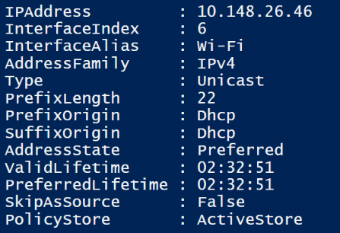
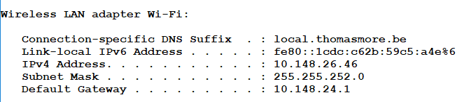
Getting information
All information on every IP on the computer:
But not nearly as interesting as ipconfig…
No DNS-suffix
No Default Gateway
No DNS-IP’s
…
Get-NetIPAddress

Slide 5
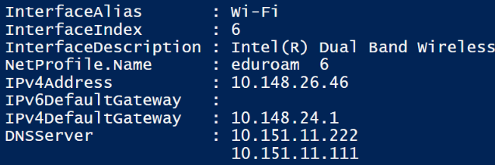
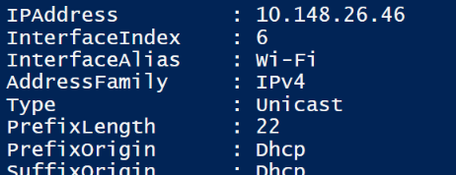
Getting information
Because you’re using the wrong cmdlet
Still missing: Subnetmask!
… but the subnetmask was present in the Get-NetIPAddress
… and it doesn’t say that the “IPv4Address”-property is a string
Now we get the same information as two slides ago, but it’s useful
Get-NetIPConfiguration
$conf = Get-NetIPConfiguration -InterfaceAlias "Wi-Fi"
$conf.IPv4Address

Slide 6
Intermezzo: prefix length
The subnetmask as show in ipconfig: 255.255.252.0
This is the dotted decimal notation
… converted to binary: 1111 1111.1111 1111.1111 1100.0000 0000
Count the number of 1’s, starting from left: 22
This is the prefix-length shown in Get-NetIPAddress
IPv6 doesn’t use the dotted decimal notation for subnetmasks any more, but only the prefixes
Because then a subnetmask would a whole bunch of F’s
Therefore, PowerShell scrapped the use of the dotted decimal for subnetmasks altogether
Notes:
https://gallery.technet.microsoft.com/scriptcenter/Convert-IPv4-Address-To-f1d4a773
Unblock-File .\Convert-IPv4.ps1
Set-ExecutionPolicy -ExecutionPolicy Bypass -Scope Process
Import-Module .\Convert-IPv4.ps1

Slide 7
Get network adapters
Get-NetAdapter show all networkadapters
More or less the same as the screen in Control Panel
Get-NetIPInterface shows all IP-interfaces
One for every IP set on your computer (IPv4 and IPv6)
When looking for a networkadapter, use the first commandlet
Take note of the interface index (ifIndex-property)
We’ll be using that to set IP addresses

Slide 8
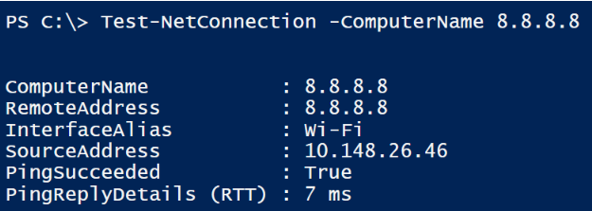
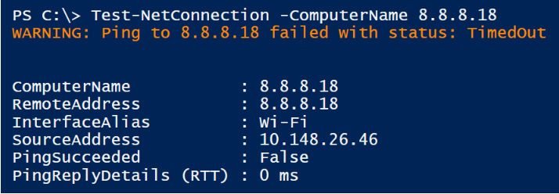
Ping
Ping: Test-Netconnection
Ping was nice and simple, but test-netconnection is nice and complicated (in a good way)
All of google’s IP’s?
Tracert?
Test-NetConnection -ComputerName www.google.com -InformationLevel Detailed
Test-NetConnection -ComputerName bad.horse -TraceRoute -Hops 100

Slide 9
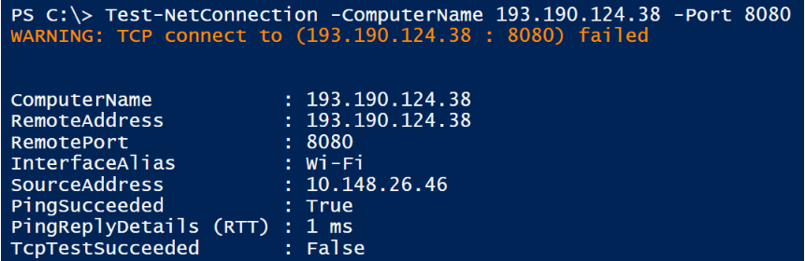
Ping
But the coolest of all:
PingSucceeded: Server is running and reachable
TcpTestSucceeded: Port 8080 isn’t listening (or reachable)

Slide 10
Set an IP
An IP needs to be set on a certain network adapter
You can
Use the interfacealias
Use the interfaceindex
In the following slides we’ll always use the interfaceindex 8

Slide 11
Set DNS
Set a certain DNS-server
IP is an array, so a list (e.g. 172.20.0.2,172.20.0.3) can be used
Set DNS-servers to dynamic
This setting is independent of other IP-settings like the IP, default gateway, …
Set-DnsClientServerAddress -InterfaceIndex 8 -ServerAddresses 172.20.0.2
Set-DnsClientServerAddress -InterfaceIndex 8 -ResetServerAddresses

Slide 12
Set IP to dynamic
This sets the IP-address to dynamic for that interface
Take note:
Default Gateway isn’t cleared
DNS-servers aren’t cleared
Ipconfig /release and /renew: No direct alternative
Unless…
Not very elegant. Also, you can’t filter on interface index.
Set-NetIPInterface -InterfaceIndex 8 -Dhcp Enabled
Restart-NetAdapter -Name "Ethernet"

Slide 13
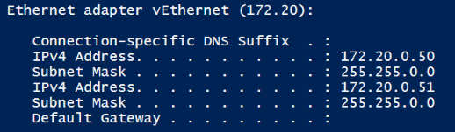
Set IP to static
The interface is set to dynamic:
Perform twice to set two IP-addresses on one interface
Clear a existing IP-address without setting to dynamic:
Change the properties of an existing IP-address:
New-NetIPAddress -InterfaceIndex 8 -IPAddress 172.20.0.50 -PrefixLength 16
Remove-NetIPAddress -InterfaceIndex 8 -Confirm:$False
Set-NetIPAddress -IPAddress 172.20.0.50 -PrefixLength 17

Slide 14
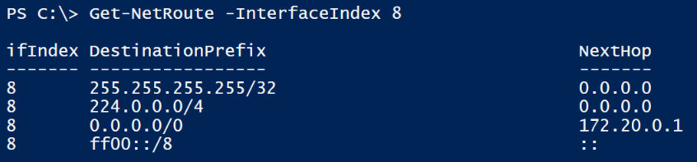
Default Gateway
A default gateway can be set using New-NetIPAddress
But once set, it can’t be removed with Remove-NetIPAddress
Or changed with Set-NetIPAddress
Because a default gateway is a default route
New-NetIPAddress -InterfaceIndex 8 –IPAdd… -Pre… -DefaultGateway 172.20.0.1

Slide 15
Default Gateway
So removing the default gateway, is removing the default route
You can’t change a default gateway using “set-netroute”, because this cmdlet doesn’t allow changing the nexthop-ip
You can set a new default gateway without changing the IP with new-netroute…
But if you don’t delete the old one first, you’ll have two default gateways
Remove-NetRoute -InterfaceIndex 8 -Confirm:$False
New-NetRoute -InterfaceIndex 8 -DestinationPrefix "0.0.0.0/0" -NextHop 172.20.0.15

Slide 16
DNS client
Check the local DNS cache:
Ipconfig /displaydns
Get-dnsclientcache
Empy the local DNS cache:
Ipconfig /flushdns
Clear-dnsclientcache
Register the computer in the DNS zone:
Ipconfig /registerdns
Register-dnsclient

Slide 17
DNS Server service
Only available on a DNS server (like your domain controller):
Show the server cache:
show-dnsservercache (not get-dnsservercache)
Empty the server cache:
Restart-service dns
Clear-dnsservercache
Nslookup:
Test-dnsserver –ipaddress 10.151.11.111 -zonename “dom.tm”

Slide 18
In conclusion
Getting information (what you did with ipconfig) is quite easy
Except for ipconfig /release and ipconfig /renew
Setting IP’s is complicated
But that was also difficult in DOS (netsh anyone?)
Managing DNS is also quite easy (but that was just another application of ipconfig)
Ipconfig is far from deprecated (we hope), so it’s not as much that you should switch, but that you can

